Slide 1
Regular Expression in java
Govind Kumar​

Slide 2
AGENDA
Introduction​
JAVA Regex
​Matcher Class
Pattern Class
​Regex Characters Class
Regex Quantifiers
Regex Metacharacters

Slide 3
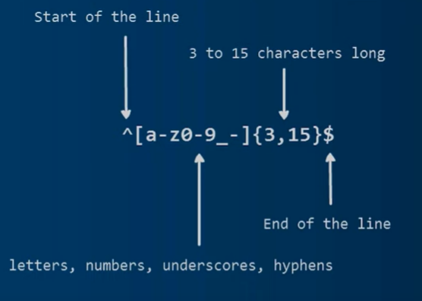
What is regular expression
A Regular Expression is a sequence of characters that constructs a search pattern. When you search for data in a text, you can use this search pattern to describe what you are looking for.

Slide 4
The java regex is an API which is used to define a pattern for searching or manipulating strings. It is widely used to define the constraint on string such as password and email validation.
What is JAVA Regex?
“
”

Slide 5
Matcher Class
The java. util. regex. Matcher class acts as an engine that performs match operations on a character sequence by interpreting a Pattern.

Slide 6
Matcher class
boolean matches() | Tests weather the given regular expression matches or not
boolean find() | Used to find the next expression that matches the pattern
boolean find(int start) | Searches the next expression from the given start number
String group() | Used to return the matched sequence
int start() | Returns the starting index
int end() | Returns the ending index
Int groupCount() | Returns the total number of matched sequence

Slide 7
Pattern Class
A compiled representation of a regular expression.
It is used to define a pattern for the regex engine.

Slide 8
pattern class
Static Pattern compile(String regex) | It compiles the given regex and returns the instance of a pattern.
Matcher matcher(charSequence input) | Used to create a matcher that matches the given input with the pattern.
Static boolean matches(String regex) | It works as a combination of compile and matcher methods.
String split[] | Used to split the given String around matches of a given pattern
String pattern() | Helps to return the regex pattern
Int end() | Returns the ending index

Slide 9
Regex character class
A character class is a set of characters enclosed within square brackets. It specifies the characters that will successfully match a single character from a given input string.

Slide 10
Regex character class
[abc] | a, b or c (A Simple class)
[^abc] | Any class except a, b or c (negation)
[a – zA - Z] | A through Z or a through z inclusive (Range)
[a - d[m - p]] | A through d or m through p (union)
[a - z&&[def]] | d, e, or f (Intersection)
[a - z&&[^bc]] | a through z except b or c (Subtraction)
[a - z&&[^m - p]] | a through z and not m though p (Subtraction)

Slide 11
Regex quantifiers
The quantifiers specify the number of occurrences of a character.

Slide 12
Regex quantifiers
X? | X occurs once or not at all
X+ | X occurs more than one times
X* | X occurs xero or more times
X{n} | X occurs n times only
X{n, } | X occurs n or more times only
X[y, z} | X occurs at least y times but less than z times

Slide 13
Regex metacharacters
Metacharacters are characters with special meanings in Java regular expression.

Slide 14
Regex metacharacters
. | It can be any character
d | Represents any digits
D | Represents any non digit
s | Represents any white space
S | Not white space character
w or W | It can be a word character
b | Represents a word boundary
B | Represents a non word boundary

Slide 15
THANK YOU
Guys For Listening.

